Slide 1
Wireframes Minecraft Guide
By CALIENDO François

Slide 2
Summary Page

Slide 3

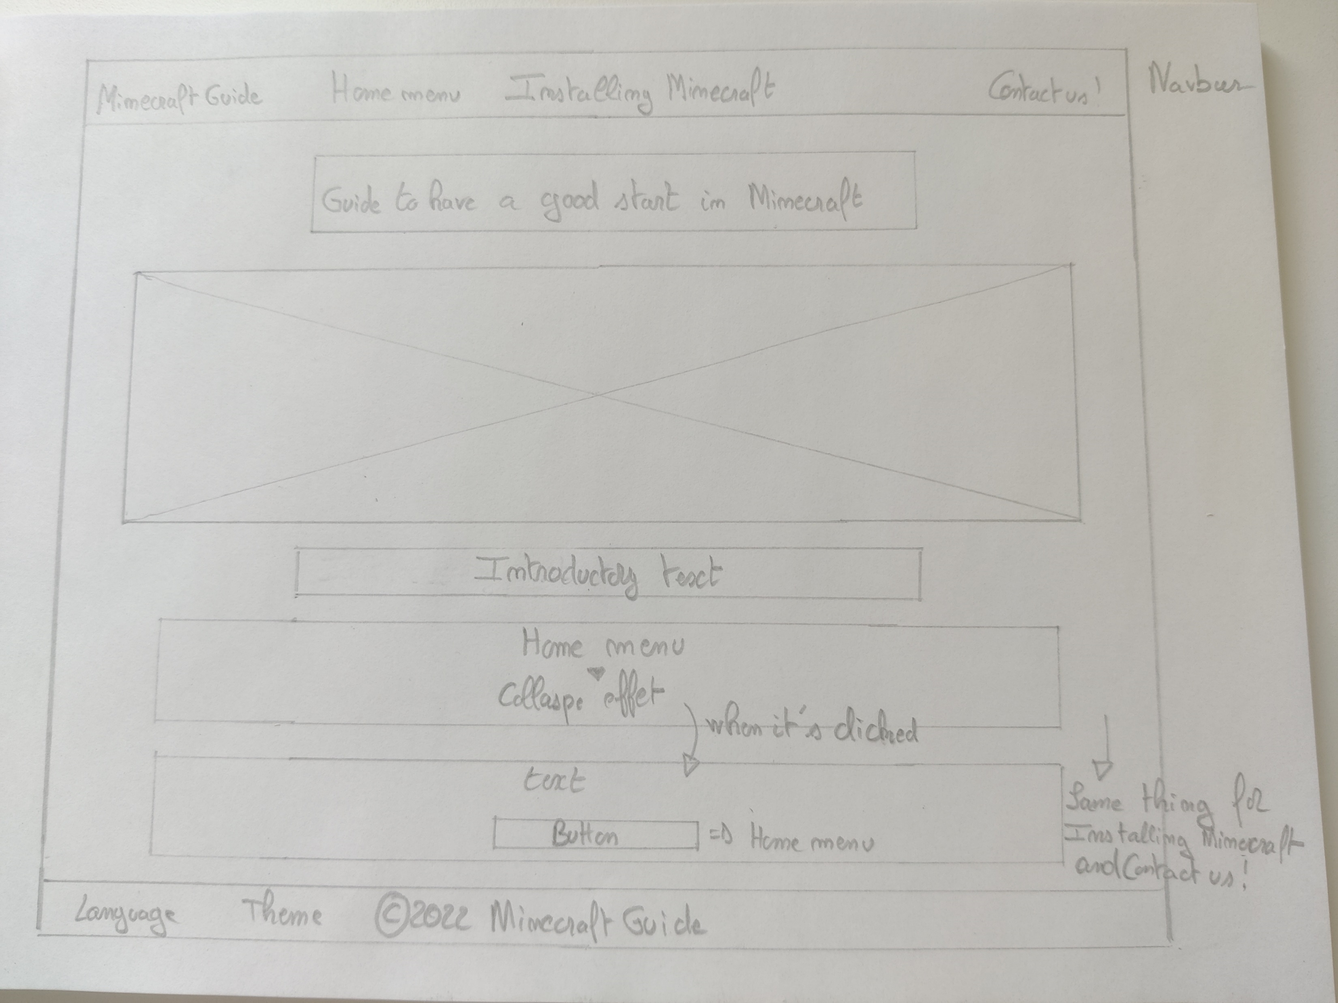


Slide 4
Home Menu

Slide 5
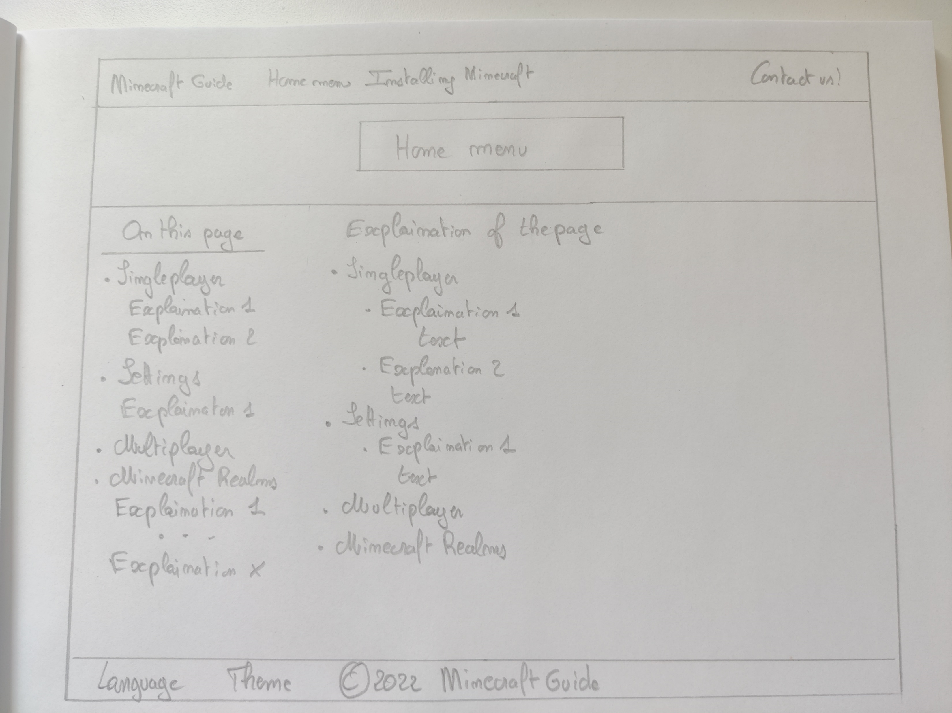

Slide 6
Installing Minecraft

Slide 7
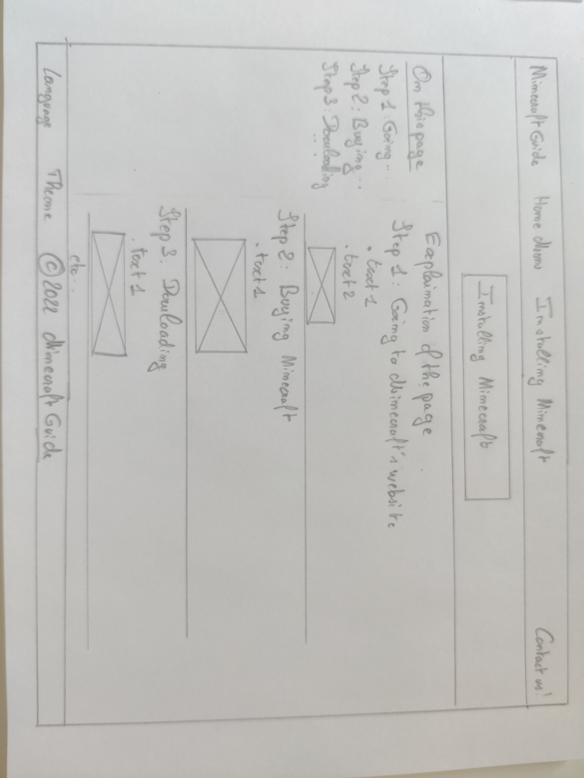

Slide 8
Contact Page

Slide 9
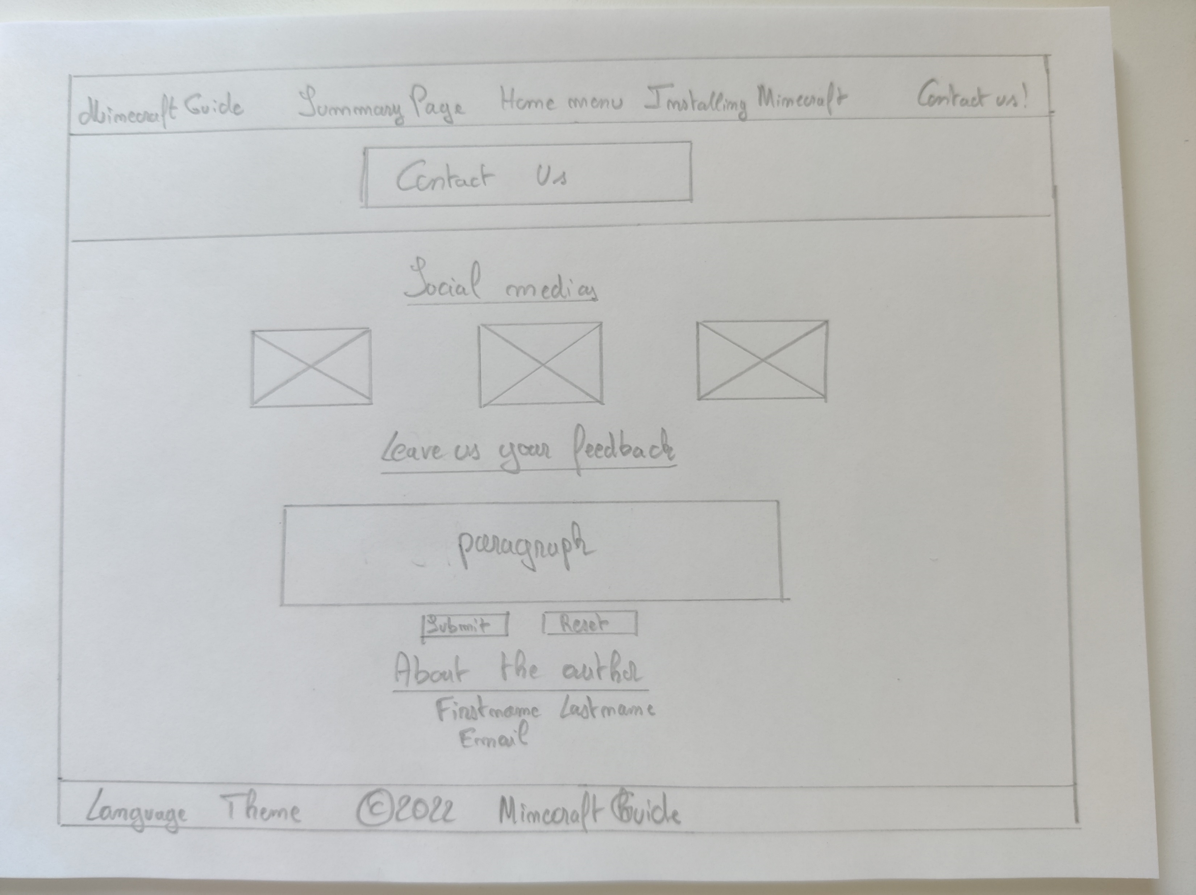

Slide 10

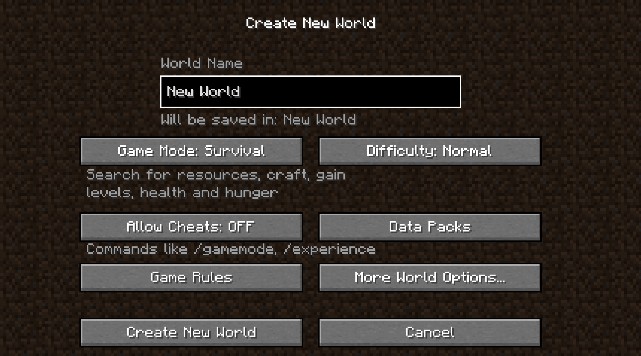
1
2
3
4
5
6
7
12
13

Slide 11
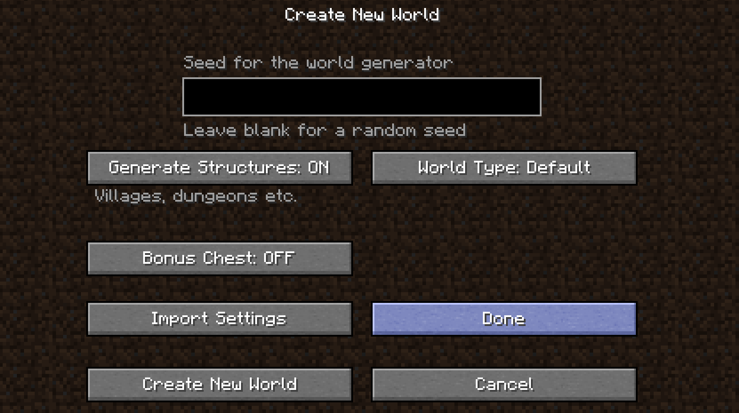
7
8
9
10
11
12
13

